Slide 1
MyDoctor
The Future of AI-Powered Telehealth
HCT1: Parviz Ali, Ben Prescott, Kasia Kostyuk, Sean Yuan

Slide 2
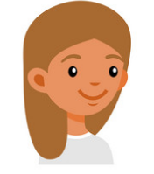
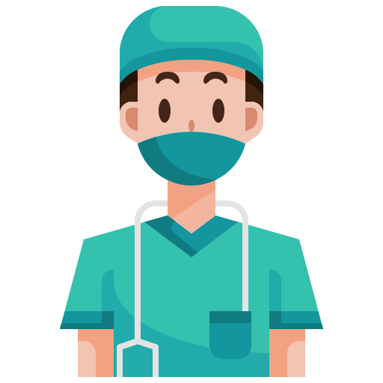

The Business Problem
4 days to schedule an appointment
18 minutes in waiting room
10 minutes filling out paperwork
15 minutes asking questions and taking measurements
Questions: symptoms, diet, exercise, family history, allergies, medications.
All of which could be answered remotely
5 minutes asking similar questions from the medical assistant
They provide a prescription
You’re done
Doctor goes to fill out paperwork
Currently, patients have to spend a fair amount of time securing an appoint and visiting the clinic.
Medical assistants and doctors spend a lot of time acquiring routine and basic information from the patient.
Much of this can be done remotely, saving time for everyone.
Notes:
Kasia

Slide 3
Introducing MyDoctor
MyDoctor, an Artificial Intelligence-powered Telehealth application which aims to provide faster and more efficient patient care by reducing patient waiting times and time spent in the clinic.
Patients will be able to log in to the MyDoctor mobile or desktop application, create a case, describe their symptoms to an AI chatbot, answer the AI’s questions, and provide pictures or videos to the doctor.
The application will then generate a symptoms report, collect the patient’s inputted information, and send the information to the nearest provider in the patient’s network.
Notes:
Kasia

Slide 4
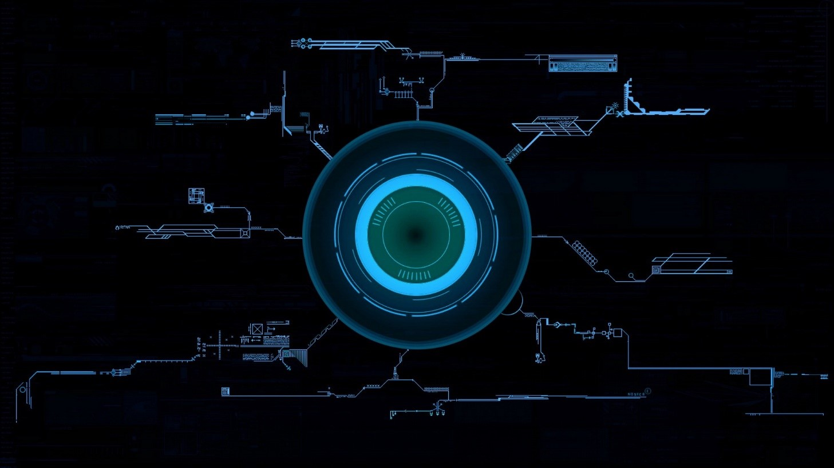
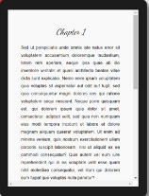
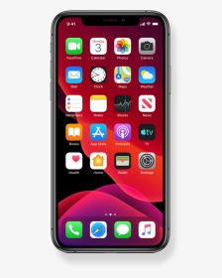
MyDoctor AI Telehealth Solution
Patient opens the app as soon as they experience symptoms
Patient only has to enter routine medical information once
Spends 5-15 minutes talking with MyDoctor AI to describe symptoms
MyDoctor AI uses ML algorithms to turn patient’s speech info a simple, distilled symptoms report for the doctor
The AI knows to ask relevant questions that a medical assistant or doctor would ask
Doctor spends 10-15 minutes reviewing the distilled report
Doctor takes remote action, such as scheduling tests or writing prescriptions
Paperwork is streamlined as patient’s information is already sent over via API
Doctors can sooner and more quickly act on this symptoms report by remotely prescribing drugs, recommending treatment, recommending a specialist or test, or recommend the patient come in.
By moving the initial consultation to telehealth, patients can reduce or remove time spent in the clinic, and doctors can more quickly recommend treatment for simple cases.
Notes:
Kasia - 3 minute mark

Slide 5
Development Approach
The successful development of MyDoctor will require strategic partnerships with healthcare organizations, such as Northwestern Medicine and Mayo Clinic.
This will allow us to leverage real-world data and scenarios to develop the application, while leveraging our partners for testing the application and providing patient and doctor feedback.
This provides our development teams with an interface into medical centers, while being able to leverage an agile project management approach with the organization points of contact, providing a consistent feedback loop between developers and healthcare professionals.
Notes:
Ben

Slide 6
MyDoctor’s Expected Benefits
MyDoctor’s primary goal is to leverage advancements in technology to reduce the waiting times for patients to be connected with a primary care doctor.
This goal comes with auxiliary benefits like:
Increased convenience for the patients.
AI-driven information to support a doctor’s diagnosis.
Increased cost savings for both patients and clinics.
Increased efficiency of doctors and allow them to provide care to more patients
Notes:
Ben

Slide 7
Measuring MyDoctor’s Success
We will initially collect metrics similar to other mobile applications, such as:
Number of users/downloads
Daily active users
Percentage of returning users over the course of a month
Additional data will be collected to determine product launch success, such as:
Percentage of patients who resolve their case completely through the app
Time savings for doctors and medical assistants who ask patients basic medical questions
Number of patients seen by doctors enrolled in MyDoctor
Patient and doctor satisfaction survey results
Notes:
Ben - 6 minute mark

Slide 8
Data Acquisition Strategy
Medical information
Common symptoms
NIH Unified Medical Language System
Web MD Symptom Checker
NIH ICD 10 (International Classification of Diseases)
Diagnostic assistance
Partnerships with Northwestern Medicine, Stanford Medicine, and Mayo Clinic
Training data for AI
Audio samples
Google’s NLP Machine Learning Cloud Platform
Speech-to-text
Other information
Patient-submitted medical history
Clinic and insurance data
Notes:
Sean (6,7) - “As mentioned before, our AI app will use medical information to predict which relevant questions a doctor would ask. This requires pulling medical information from resources like ###. We will train the AI with ###

Slide 9
Risks
AI-powered technology for medical diagnosis is still new and unproven
Library of medical information is not easily structured for machine learning
Successful projects using ML for image recognition and diagnosis has been very specialized (Google Health Retinopathy)
Strategies to mitigate risk
Simplify functionality - focus on classification of symptoms and distilling information for the doctor
Focus on patient-doctor communication - AI chatbot serves to streamline the doctor-patient interaction, not replace it
Work closely with medical partners - create strong bonds with academic and industry experts to push the envelope on medical AI
Notes:
Sean (7,8) - Risks to our project are thus follows: 1) AI-powered medical diagnosis is still a new and unproven technology. IBM’s Deep Watson promised to make this a reality, but so far our research has shown it has fallen short. 2) ### 3) ###

Slide 10
Dependencies
Google AI Cloud Platform
Data storage, machine learning, classification algorithms, NLP
Partnerships with medical experts
Northwestern medicine, Stanford Medicine, and Mayo Clinic
Adoption for pilot testing
Find the right clinic who is willing to help us test MyDoctor AI
Notes:
Sean (8,9)

Slide 11
Technology
Google AI Cloud Platform
Data Storage
NLP
Machine Learning
Classification
Hadoop Cloud
Data Storage
Unstructured, semi-structured data
Patient medical history
Apache suite of tools
Algorithms
Prediction and Classification
CNN models
Random Forest
Notes:
Sean (9,10)

Slide 12
Timing and Project Management
Timeline - 1 year for research and prototyping, developing over a 12 week agile cycle. Pilot after 1 year.
Project Management style: Agile/Waterfall hybrid, using Monday to manage project.
Data Mining: CRISP-DM Approach
Notes:
Sean - (10,11) minute mark

Slide 13
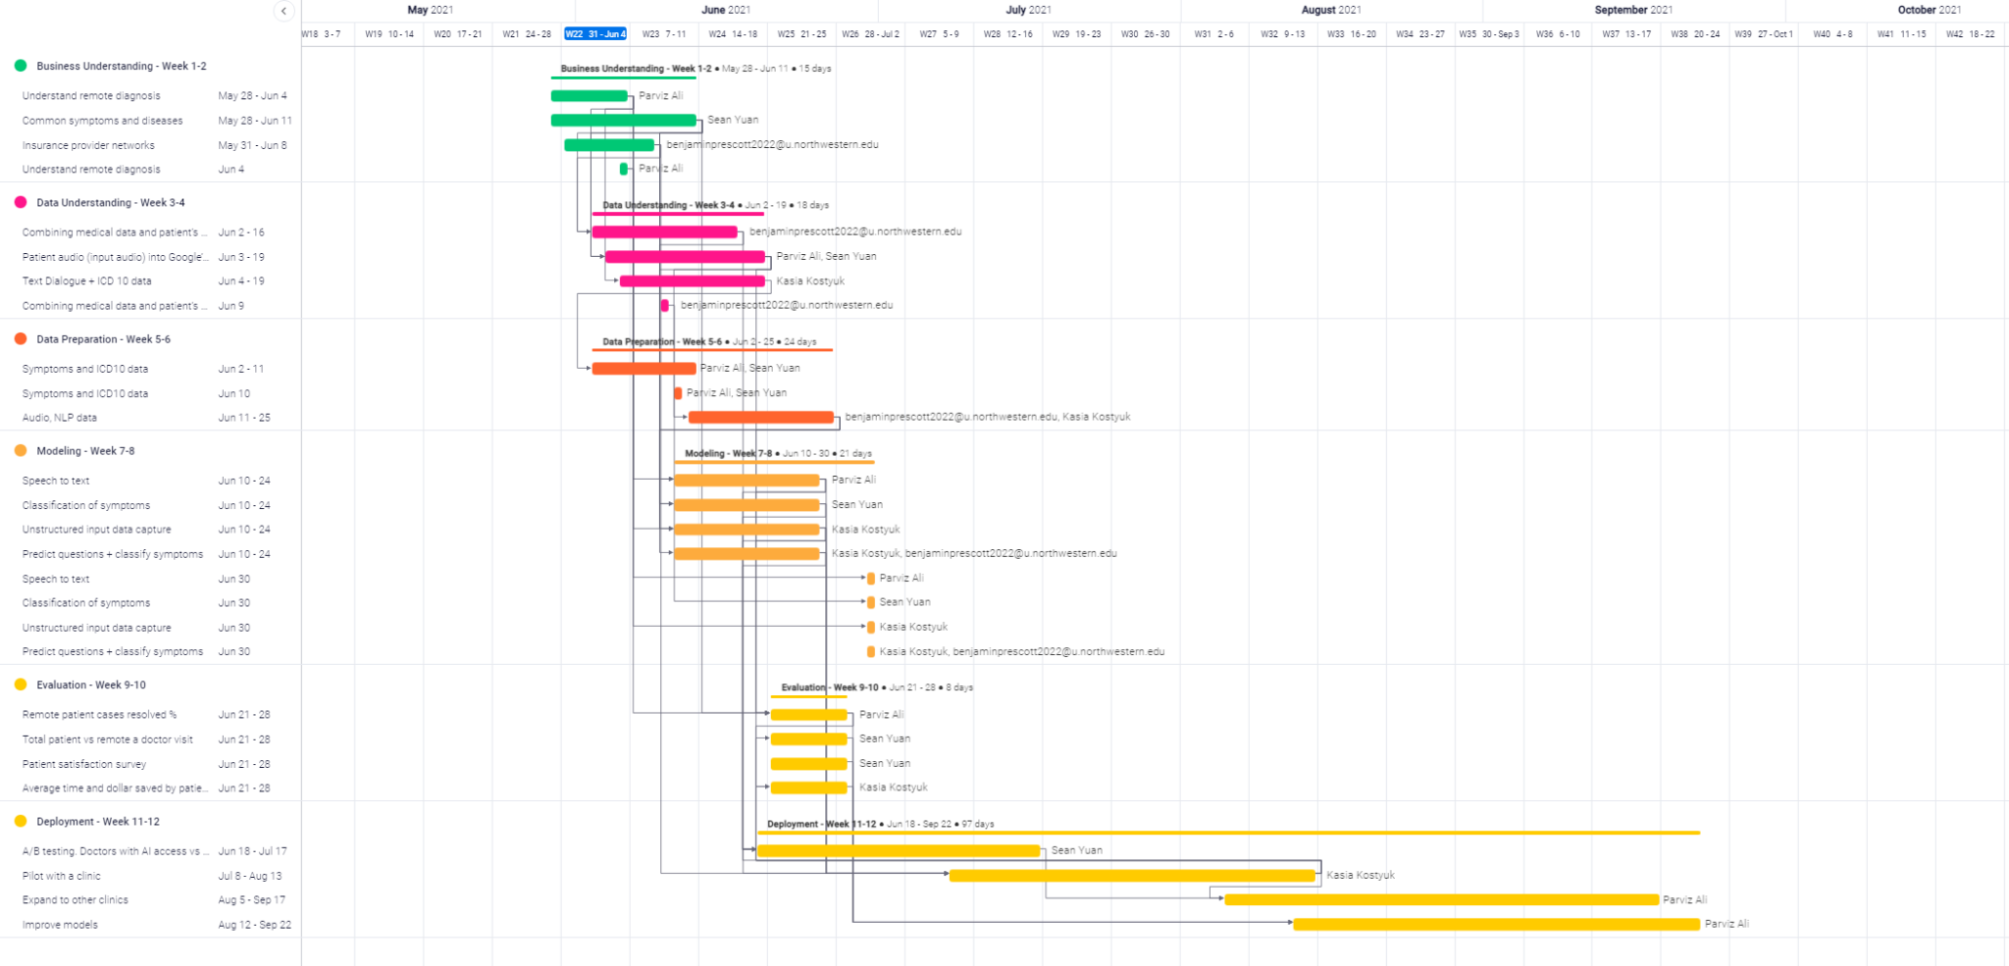
Project Management Plan Timeline
Notes:
Parviz

Slide 14
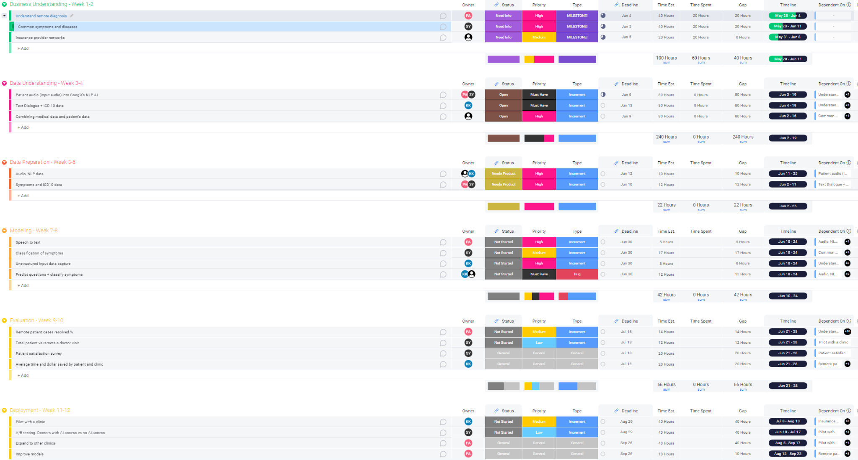
Project Management Plan Details
Notes:
Parviz - 13 minute mark

